Slide 1


InsideAirBNB
PRICE PREDICTION
Insights and analysis of AirBNB property listings of San Francisco

Slide 2




PRESENTATION
OUTLINE
Objective
Data collection
Data preprocessing
Explorative Data Analysis
Feature Engineering
Data Modelling
Model Evaluation
Interpretation
Recommendation

Slide 3
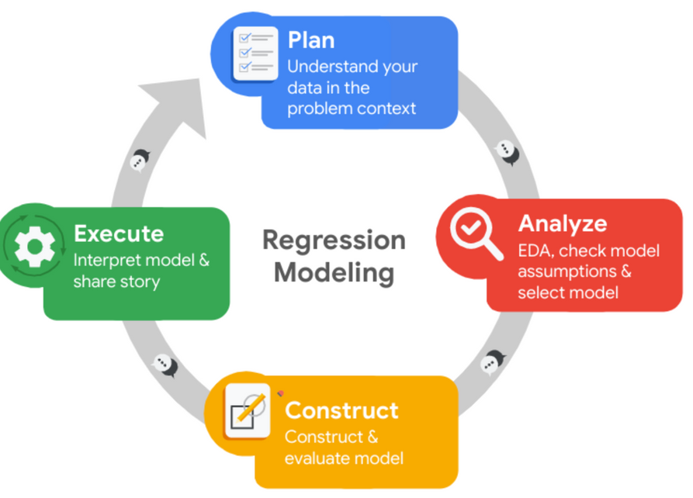
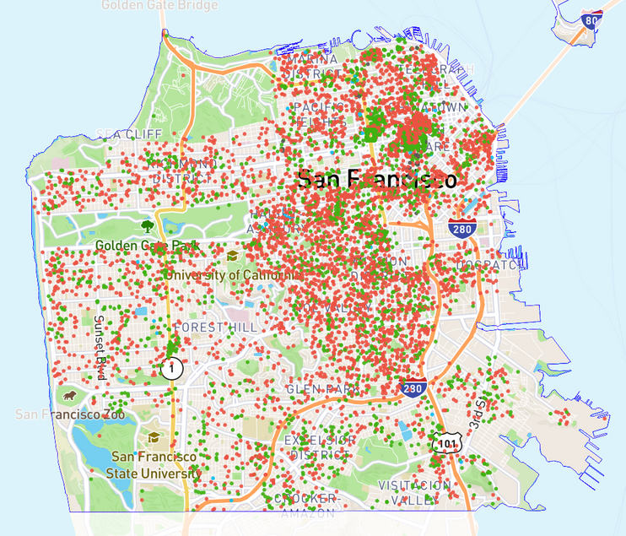
OBJECTIVE
Audience: AirBNB property owners looking to improve business.
Problem Statement: Prediction of prices for properties based on relevant features.
Solution: Conduct data analysis of dataset and build a regression model using machine learning.
DATA COLLECTION
Dataset: AirBNB listings of Sans Francisco.
Data Source: http://insideairbnb.com/san-francisco
Dataset Condition: 8055 entries and 16 columns
csv file converted to pandas dataframe.

Slide 4
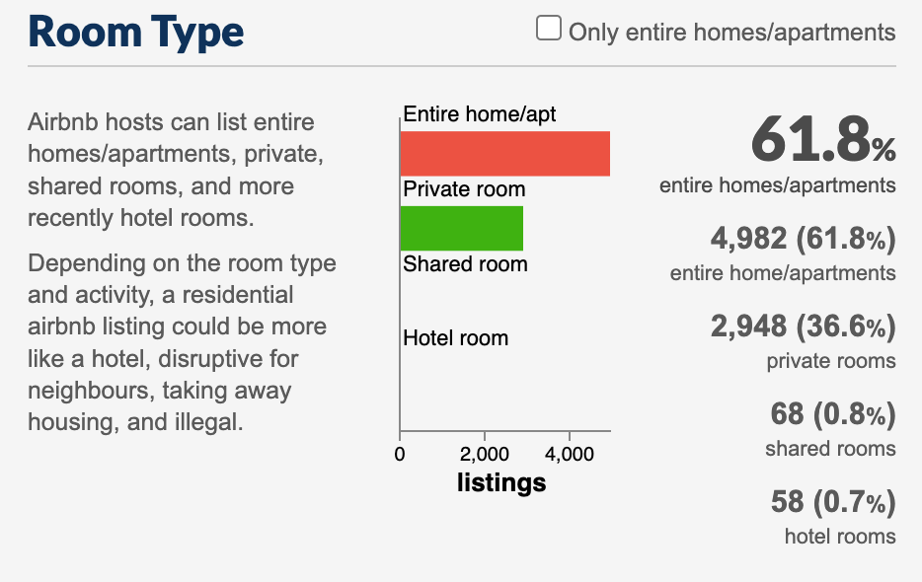
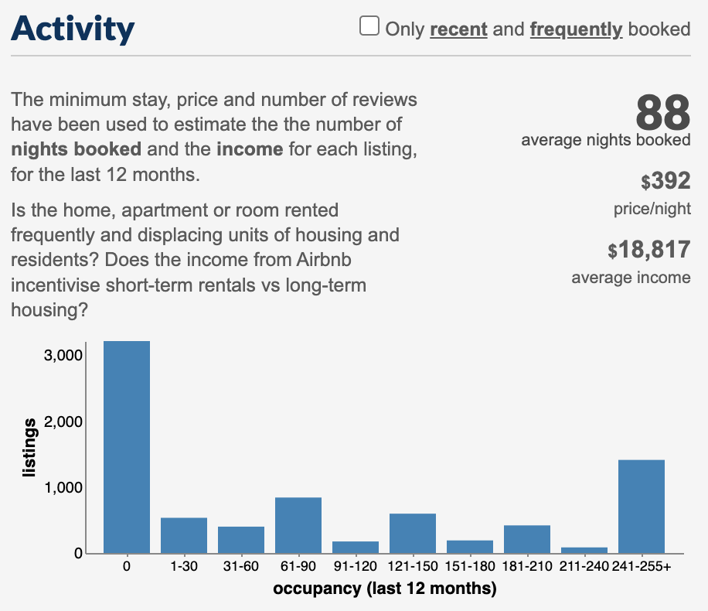
PRELIMINARY ANALYSIS

Slide 5
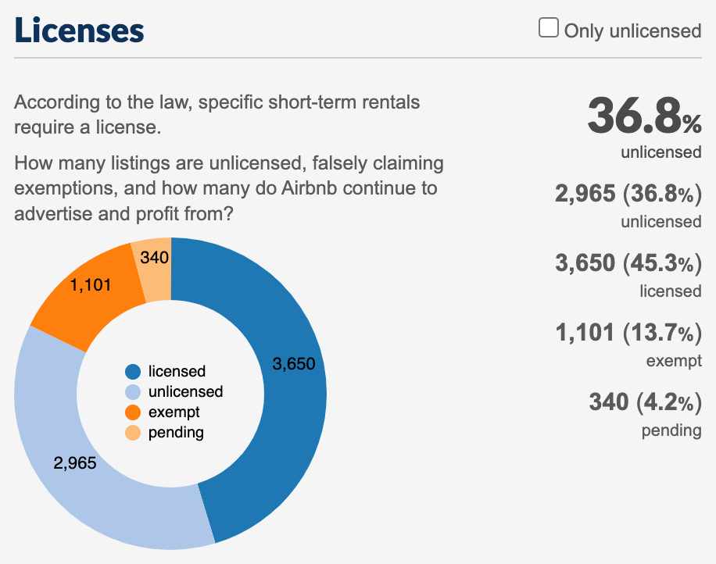
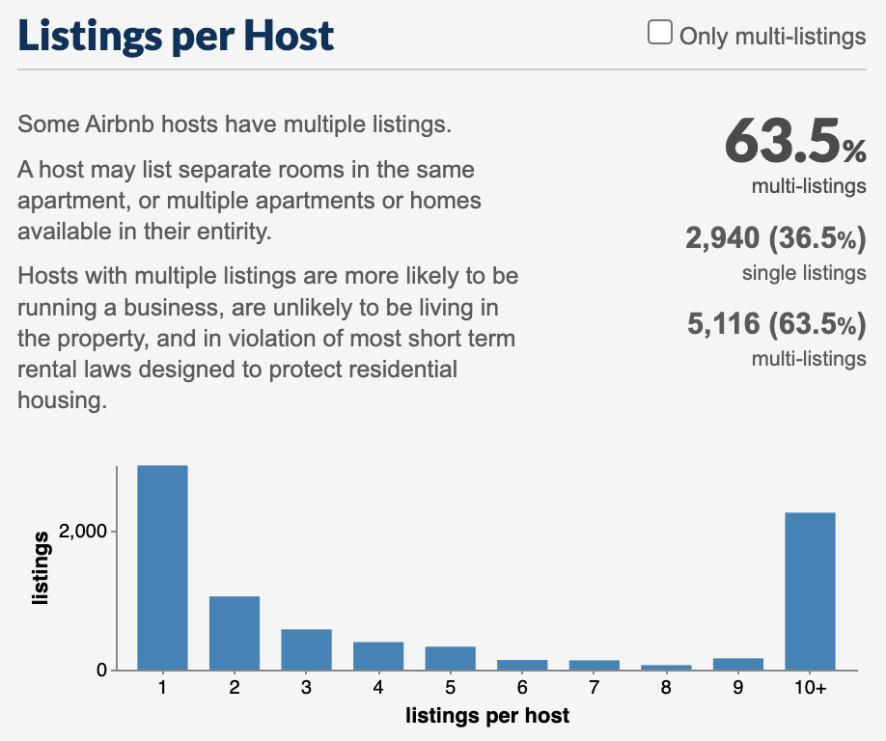
PRELIMINARY ANALYSIS

Slide 6
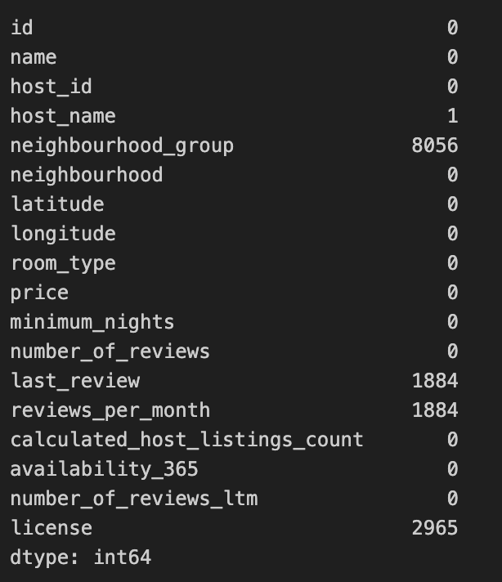
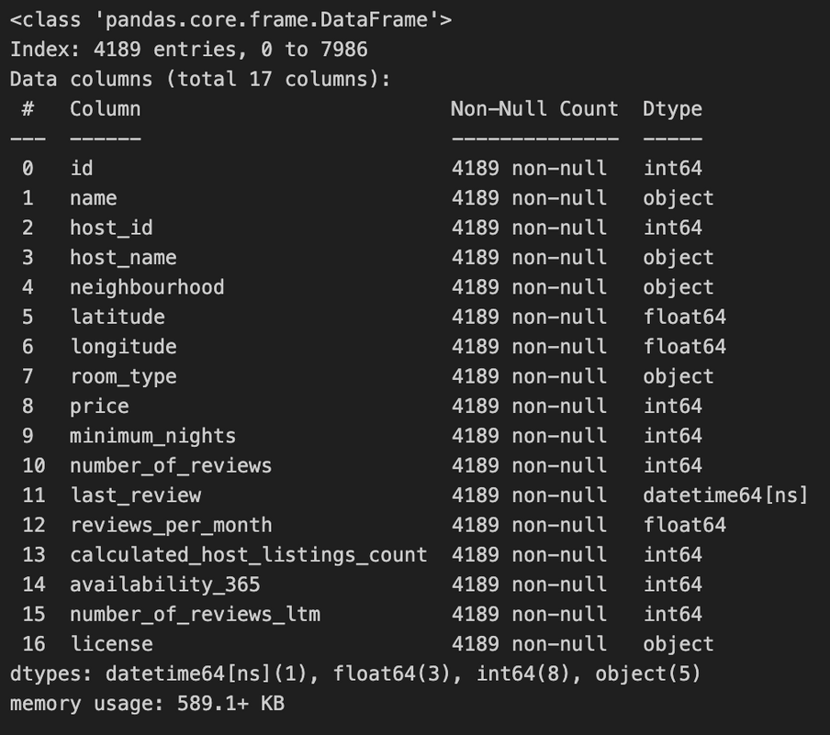
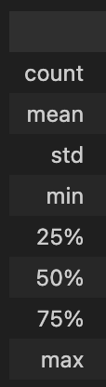
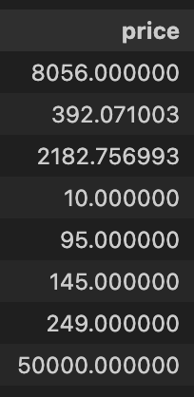
DATA PREPROCESSING
Removing null values using :
dropna() and isna()
Dataset Info:
Datatype of ‘last review’ changed to Datetime64[ns]
No duplicates found.
Fundamental statistics of
dataset using describe()

Slide 7
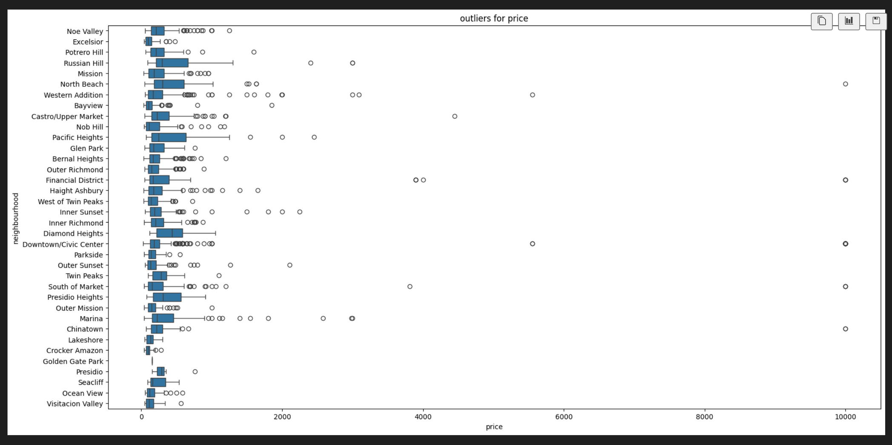
HANDLING OUTLIERS
Boxplot of Price vs Neighbourhood
The prices of few properties were over 8000. After analysing the rows, specific properties were removed.

Slide 8
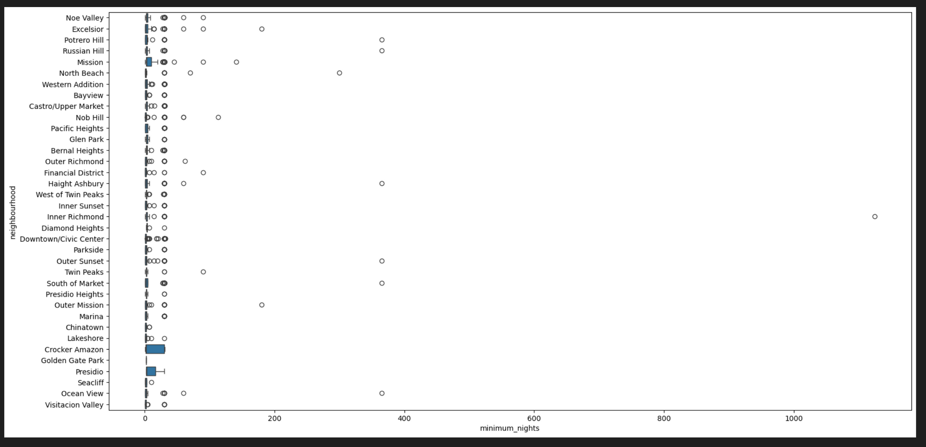
HANDLING OUTLIERS
Boxplot of Minimum Nights vs Neighbourhood
The maximum value is 366 for a year. The outlier with a value > 1000 was removed.

Slide 9
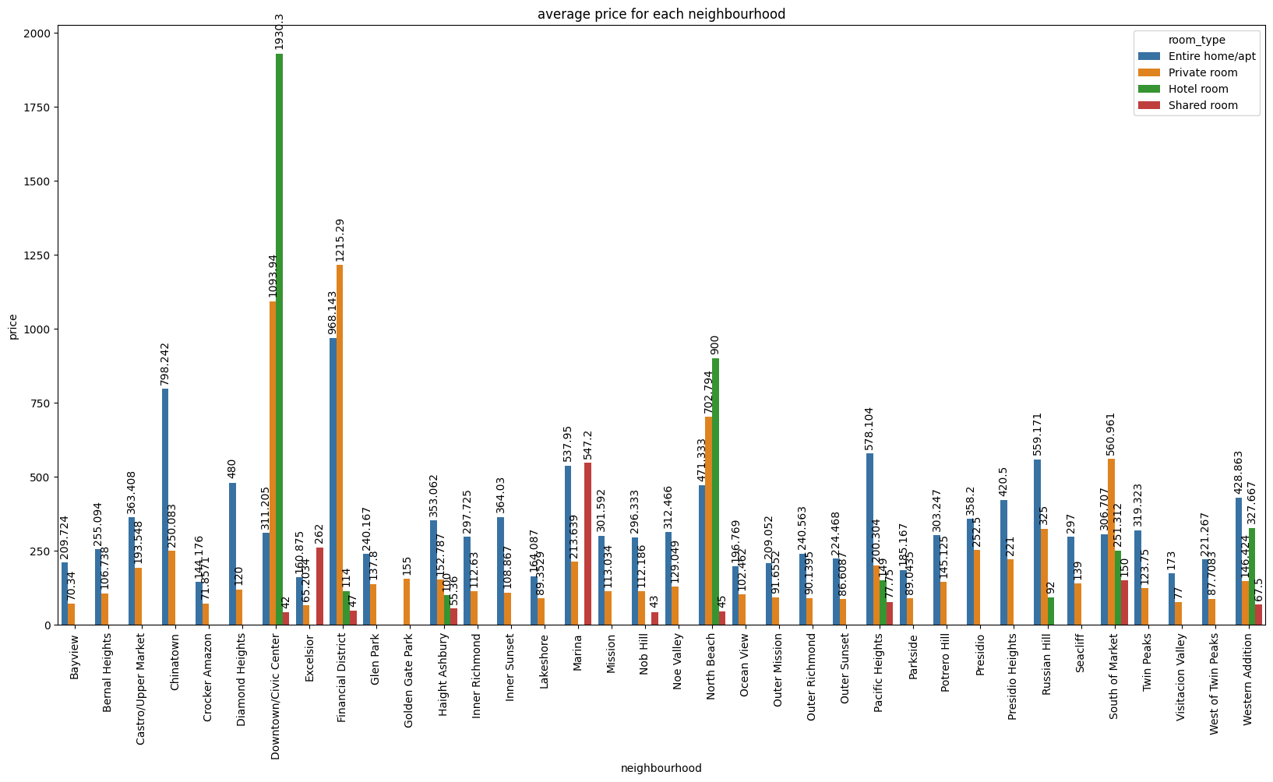
EXPLORATORY DATA ANALYSIS
Barplot of Price vs Neighbourhood indicating room types
The average price for Downtown/civic Center neighbourhood of room type ‘hotel room’ shows an unusually high value.

Slide 10
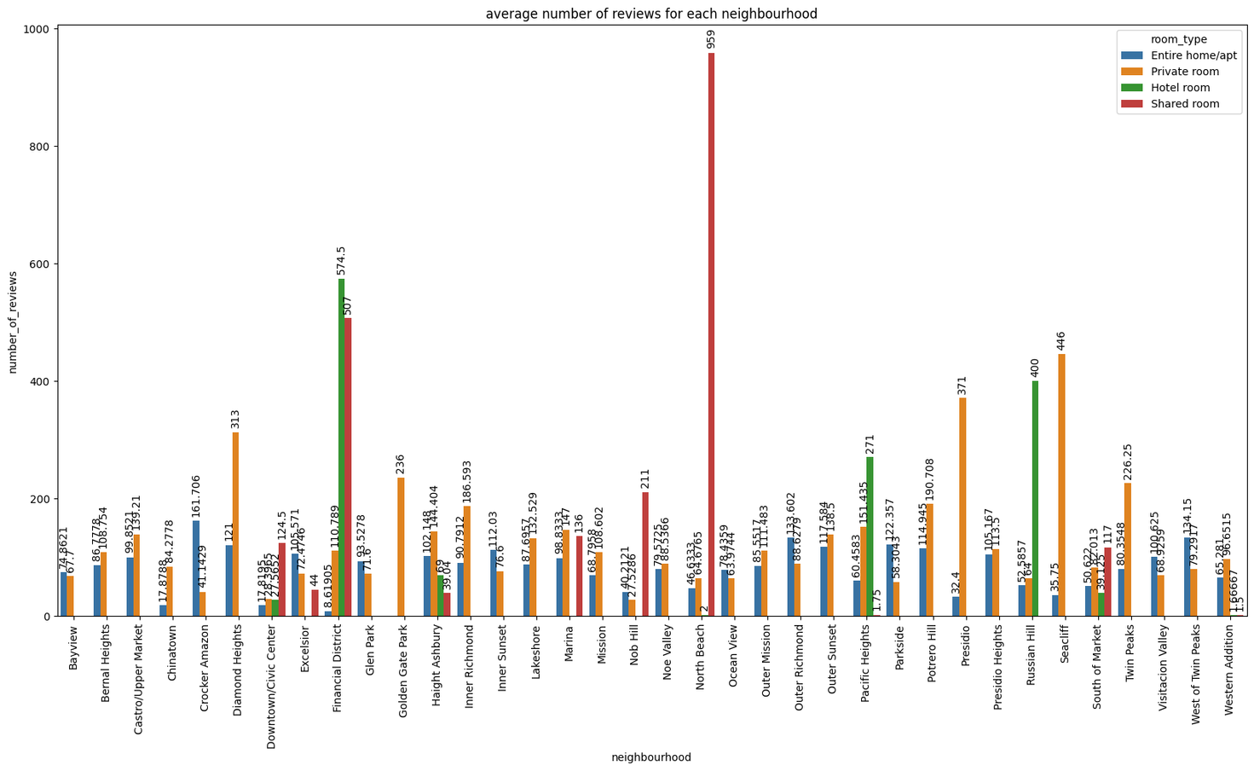
EXPLORATORY DATA ANALYSIS
Barplot of Number of reviews vs Neighbourhood indicating room types
The number of reviews for North Beach neighbourhood of room type ‘Shared room’ showed one listing with a value of 959 at a price of 45.

Slide 11
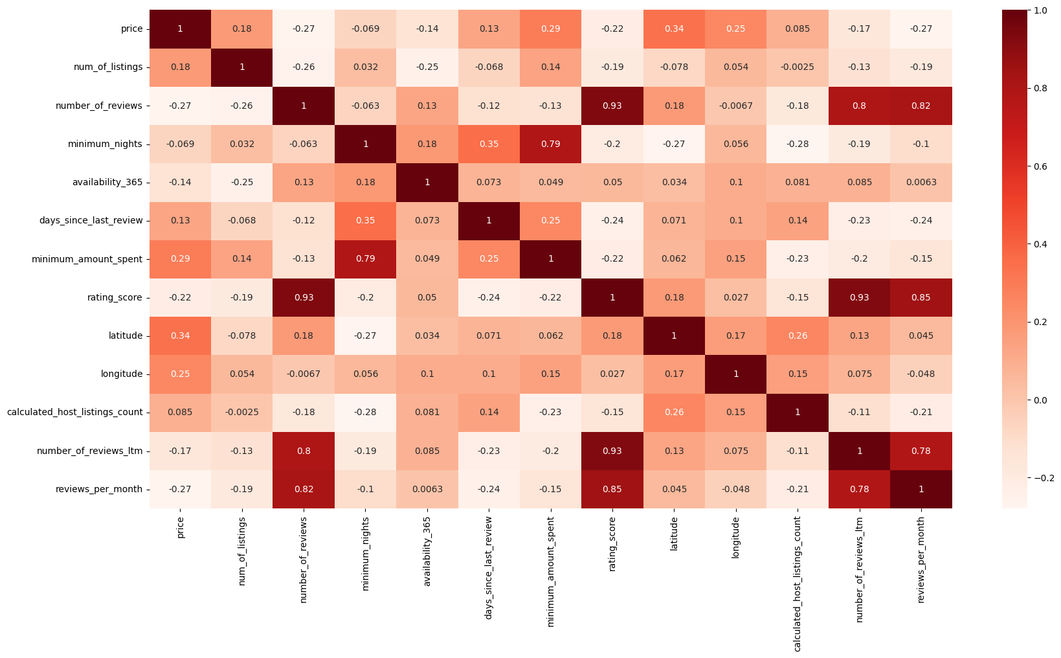
EXPLORATORY DATA ANALYSIS
Heatmap of correlation between features of dataset
The correlation did not reveal any significant relationships between the features.

Slide 12
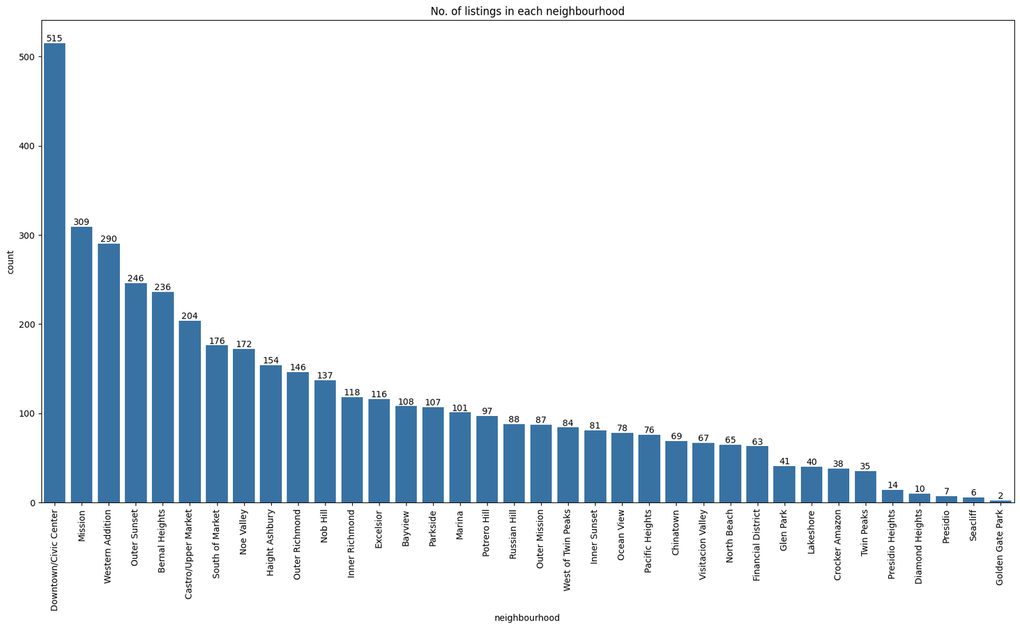
EXPLORATORY DATA ANALYSIS
Barplot of No. of listings vs Neighbourhood
The number of listings indicates the price range which is expected for each neighbourhood. The Downtown/Civic Center has the lowest reviews and a considerably high average price. The financial district neighbourhood has higher No. of reviews and a fairly high average price with lower No. of listings.

Slide 13
FEATURE ENGINEERING
Features
Days since last review = current date - date of last review
Review Score = No. of reviews / Days since last review
Minimum Amount Spent = Minimum Nights * Price
No. of listings for each neighbourhood
Average Price for each neighbourhood
Average No. of nights for each neighbourhood
Average No. of reviews for each neighbourhood
Average availability through the year for each neighbourhood

Slide 14
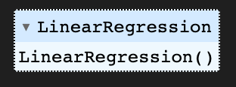
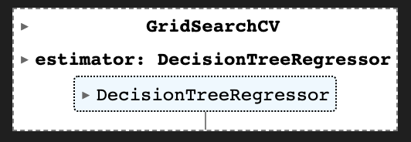
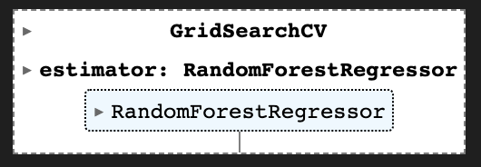
MODELLING
Categorical Encoding using pd.get_dummies() for neighbourhoods and room type.
Split the data into training, validation and test datasets.
Normalize the dataset values using StandardScaler fit and transform functions.
Built Linear Regression, Decision Tree Regression and Random Forest Regression Models.
Define a dictionary for hyperparameters.
Use GridSearchCV for Hyperparameter Tuning and Cross-Validation.

Slide 15
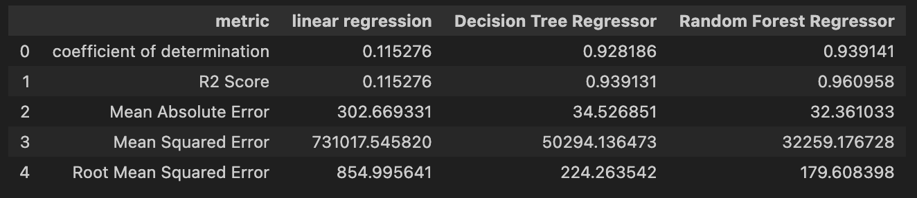
MODEL EVALUATION
Model was Evaluated on :
R2 Score
Mean Absolute Error
Mean Squred Error
Root Mean Squared Error

Slide 16
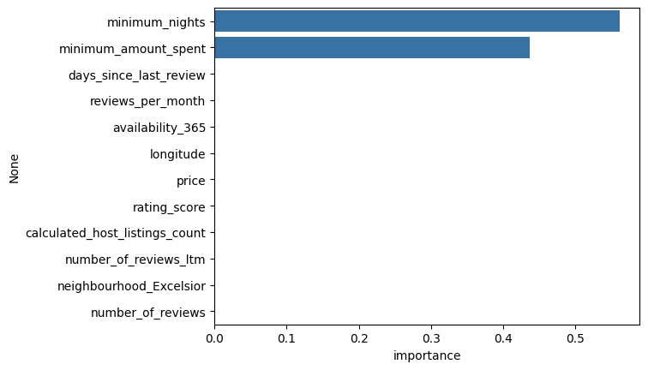
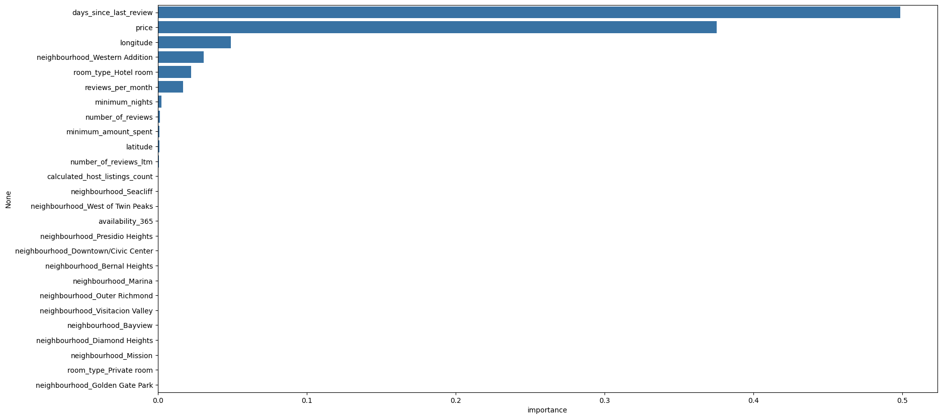
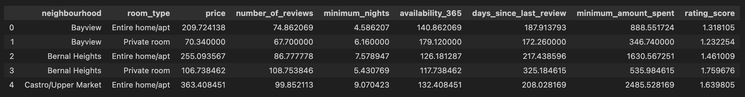
MODEL INTERPRETATION
Feature Importance based on the model’s results
The features which are most influential is the No. of nights spent, price and the frequency of reviews for a listing
The mean values for features provides insights into listings of each neighbourhood

Slide 17
PRICE RECOMMENDATIONS
An analysis of the data of San Francisco listings provided us with these key insights:
The neighbourhood of the listing affects the price significantly.
Listings with a higher minimum number of nights tend to have a higher price.
The frequency of reviews and updates contributes to a better rating.
The Financial District neighbourhood is a good place to list a property with high prices and reviews but a lower number of overall properties.
The Downtown/Civic Center has the highest number of listings with high average pricing but shows very few reviews.
There is a slight relation between the number of reviews over a year and the price. Keeping customer satisfaction high will promote good reviews constantly.
The number of reviews for a shared room in North Beach indicate a demand for this particular rentals
Local factors should also be taken into consideration before listing a property.

Slide 18

THANK YOU
The notebook with the code is available with all the visualizations.
Presented by,
Nihal K P
kpnihal006@gmail.com
+91 76761 65779
www.linkedin.com/kpnihal006/

